Slide 1

Control Statements (2) Loops
University of Human Development College of Science and Technology Department of IT
Lecture :Programming
Lecturer: Tara Qadr
1st stage 2015-2016

Slide 2
Objectives
To use while, do-while, and for loop statements to control the repetition of statements .
To understand the flow of control in loop statements .
To use Boolean expressions to control loop statements .
Using nested loops.
To know the similarities and differences of three types of loops.
To implement program control with break and continue.

Slide 3
Control Statements
Normally, statements in a program are executed in the order in which they were written.
Java provides two other ways to change the flow of control:
Selection Statements
if and if...else Statements
switch Statements
Conditional Operator
Repetition Statements
while Statement
do-while Statements
for Statements

Slide 4

Repetition Statements
A repetition (or looping) statement allows your program repeat an action while some condition remains true.
while Statement
do-while Statements
for Statements

Slide 5
Repetition Examples
Consider we want to repeat a task several times:
Write the message “Welcome to university” a hundred times.
Write numbers between 1 and 10.
Find the summation of numbers from 1 to 10.
Ask for adding two numbers until getting wrong answer.
Write the even numbers between 1 and 100.
Find the average age among students of a class.

Slide 6
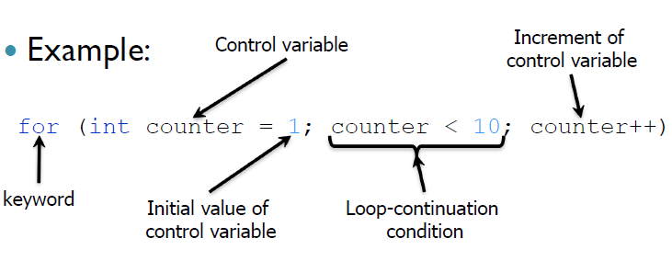
for Statement
For loop general syntax:
for(initial-action;continuation-condition;action-after-each-iteration)
{
Statement(s);
}

Slide 7
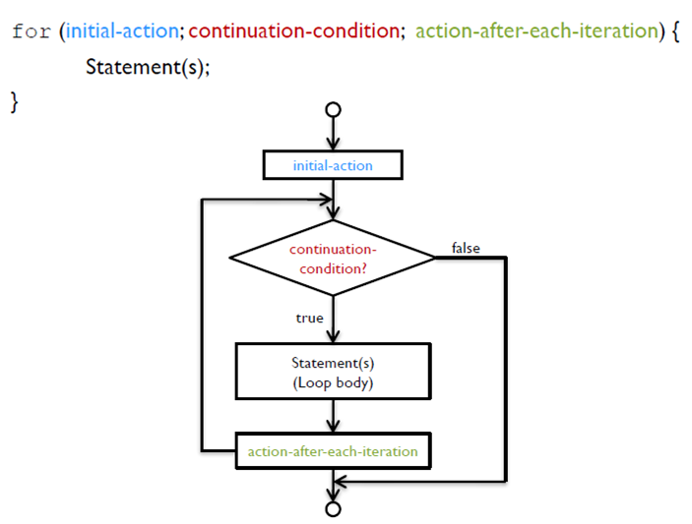
for Statement Flowchart

Slide 8
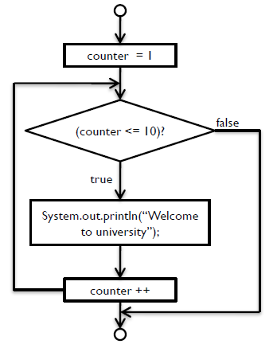
for Statement
Example:
for (int counter = 1; counter <= 10; counter++){
System.out.println (“Welcome to university”);
}

Slide 9
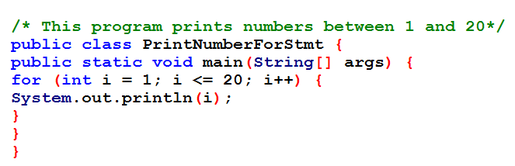
Example 1: for loop

Slide 10
Trace of Example 2: for loop (1)
/* This program finds summation of
numbers 1 to 4 and prints the
result to the screen*/
public class SumNumbersForStmt {
public static void main(String[] args) {
int sum = 0;
for (int i = 1; i <= 4; i++) {
sum = sum + i;
}
System.out.println(“Sum of numbers 1 to 4 is “+ sum);
}
}
Memory | screen
i sum
0
1-Allocate memory for sum
2-initializes sumto 0

Slide 11
Trace of Example 2: for loop (2)
/* This program finds summation of
numbers 1 to 4 and prints the
result to the screen*/
public class SumNumbersForStmt {
public static void main(String[] args) {
int sum = 0;
for (int i = 1; i <= 4; i++) {
sum = sum + i;
}
System.out.println(“Sum of numbers 1 to 4 is “+ sum);
}
}
Memory | screen
i sum
0
1
1-Allocate memory for i
2-initializes i to 1

Slide 12
Trace of Example 2: for loop (3)
/* This program finds summation of
numbers 1 to 4 and prints the
result to the screen*/
public class SumNumbersForStmt {
public static void main(String[] args) {
int sum = 0;
for (int i = 1; i <= 4; i++) {
sum = sum + i;
}
System.out.println(“Sum of numbers 1 to 4 is “+ sum);
}
}
Memory | screen
i sum
0
1
1-Value of i is smaller or
equal to five? (true)
2-Execute body of for

Slide 13
Trace of Example 2: for loop (4)
/* This program finds summation of
numbers 1 to 4 and prints the
result to the screen*/
public class SumNumbersForStmt {
public static void main(String[] args) {
int sum = 0;
for (int i = 1; i <= 4; i++) {
sum = sum + i;
}
System.out.println(“Sum of numbers 1 to 4 is “+ sum);
}
}
Memory | screen
i sum
0
1 0+ 1= 1

Slide 14
Trace of Example 2: for loop (5)
/* This program finds summation of
numbers 1 to 4 and prints the
result to the screen*/
public class SumNumbersForStmt {
public static void main(String[] args) {
int sum = 0;
for (int i = 1; i <= 4; i++) {
sum = sum + i;
}
System.out.println(“Sum of numbers 1 to 4 is “+ sum);
}
}
Memory | screen
i sum
0
1 1
2
Add 1 to i

Slide 15
Trace of Example 2: for loop (6)
/* This program finds summation of
numbers 1 to 4 and prints the
result to the screen*/
public class SumNumbersForStmt {
public static void main(String[] args) {
int sum = 0;
for (int i = 1; i <= 4; i++) {
sum = sum + i;
}
System.out.println(“Sum of numbers 1 to 4 is “+ sum);
}
}
Memory | screen
i sum
0
1 1
2
1-Value of i is smaller or
equal to five? (true)
2-Execute body of for

Slide 16
Trace of Example 2: for loop (7)
/* This program finds summation of
numbers 1 to 4 and prints the
result to the screen*/
public class SumNumbersForStmt {
public static void main(String[] args) {
int sum = 0;
for (int i = 1; i <= 4; i++) {
sum = sum + i;
}
System.out.println(“Sum of numbers 1 to 4 is “+ sum);
}
}
Memory | screen
i sum
0
1 1
2 1+2=3
Add i to sum

Slide 17
Trace of Example 2: for loop (8)
/* This program finds summation of
numbers 1 to 4 and prints the
result to the screen*/
public class SumNumbersForStmt {
public static void main(String[] args) {
int sum = 0;
for (int i = 1; i <= 4; i++) {
sum = sum + i;
}
System.out.println(“Sum of numbers 1 to 4 is “+ sum);
}
}
Memory | screen
i sum
0
1 1
2 3
3
Add 1 to i

Slide 18
Trace of Example 2: for loop (9)
/* This program finds summation of
numbers 1 to 4 and prints the
result to the screen*/
public class SumNumbersForStmt {
public static void main(String[] args) {
int sum = 0;
for (int i = 1; i <= 4; i++) {
sum = sum + i;
}
System.out.println(“Sum of numbers 1 to 4 is “+ sum);
}
}
Memory | screen
i sum
0
1 1
2 3
3
1-Value of i is smaller or
equal to five? (true)
2-Execute body of for

Slide 19
Trace of Example 2: for loop (10)
/* This program finds summation of
numbers 1 to 4 and prints the
result to the screen*/
public class SumNumbersForStmt {
public static void main(String[] args) {
int sum = 0;
for (int i = 1; i <= 4; i++) {
sum = sum + i;
}
System.out.println(“Sum of numbers 1 to 4 is “+ sum);
}
}
Memory | screen
i sum
0
1 1
2 3
3 3+3=6

Slide 20
Trace of Example 2: for loop (11)
/* This program finds summation of
numbers 1 to 4 and prints the
result to the screen*/
public class SumNumbersForStmt {
public static void main(String[] args) {
int sum = 0;
for (int i = 1; i <= 4; i++) {
sum = sum + i;
}
System.out.println(“Sum of numbers 1 to 4 is “+ sum);
}
}
Memory | screen
i sum
0
1 1
2 3
3 6
4
Add 1 to i

Slide 21
Trace of Example 2: for loop (12)
/* This program finds summation of
numbers 1 to 4 and prints the
result to the screen*/
public class SumNumbersForStmt {
public static void main(String[] args) {
int sum = 0;
for (int i = 1; i <= 4; i++) {
sum = sum + i;
}
System.out.println(“Sum of numbers 1 to 4 is “+ sum);
}
}
Memory | screen
i sum
0
1 1
2 3
3 6
4
1-Value of i is smaller or
equal to five? (true)
2-Execute body of for

Slide 22
Trace of Example 2: for loop (13)
/* This program finds summation of
numbers 1 to 4 and prints the
result to the screen*/
public class SumNumbersForStmt {
public static void main(String[] args) {
int sum = 0;
for (int i = 1; i <= 4; i++) {
sum = sum + i;
}
System.out.println(“Sum of numbers 1 to 4 is “+ sum);
}
}
Memory | screen
i sum
0
1 1
2 3
3 6
4 6+4=10
Add i to sum

Slide 23
Trace of Example 2: for loop (14)
/* This program finds summation of
numbers 1 to 4 and prints the
result to the screen*/
public class SumNumbersForStmt {
public static void main(String[] args) {
int sum = 0;
for (int i = 1; i <= 4; i++) {
sum = sum + i;
}
System.out.println(“Sum of numbers 1 to 4 is “+ sum);
}
}
Memory | screen
i sum
0
1 1
2 3
3 6
4 10
5
Add 1 to i

Slide 24
Trace of Example 2: for loop (15)
/* This program finds summation of
numbers 1 to 4 and prints the
result to the screen*/
public class SumNumbersForStmt {
public static void main(String[] args) {
int sum = 0;
for (int i = 1; i <= 4; i++) {
sum = sum + i;
}
System.out.println(“Sum of numbers 1 to 4 is “+ sum);
}
}
Memory | screen
i sum
0
1 1
2 3
3 6
4 10
5
1-Value of i is smaller or
equal to 5? (False)
2-jump to the end of for
statement

Slide 25
Trace of Example 2: for loop (16)
/* This program finds summation of
numbers 1 to 4 and prints the
result to the screen*/
public class SumNumbersForStmt {
public static void main(String[] args) {
int sum = 0;
for (int i = 1; i <= 4; i++) {
sum = sum + i;
}
System.out.println(“Sum of numbers 1 to 4 is “+ sum);
}
}
Memory | screen
i sum
0
1 1
2 3
3 6
4 10
5
1-jump to the end of for
2-execute statements after for

Slide 26
Trace of Example 2: for loop (17)
Memory | screen
i sum
0
1 1
2 3
3 6
4 10
5 | Sum of numbers 1 to 4 is 10
/* This program finds summation of
numbers 1 to 4 and prints the
result to the screen*/
public class SumNumbersForStmt {
public static void main(String[] args) {
int sum = 0;
for (int i = 1; i <= 4; i++) {
sum = sum + i;
}
System.out.println(“Sum of numbers 1 to 4 is “+ sum);
}
}
Print a message to the console

Slide 27
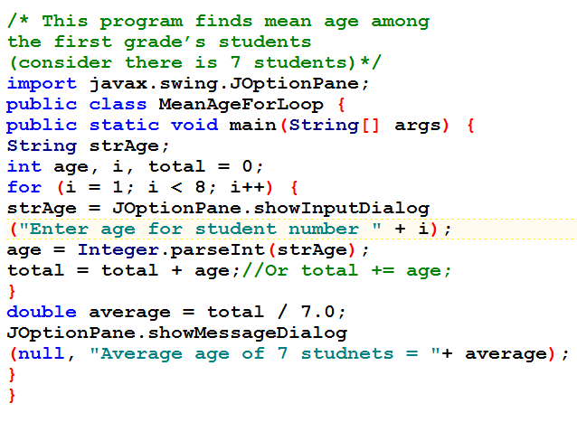
Example 3: for loop

Slide 28
Homework
Rewrite previews program, to let the user enter10 numbers, then counts even and odd numbers.

Slide 29
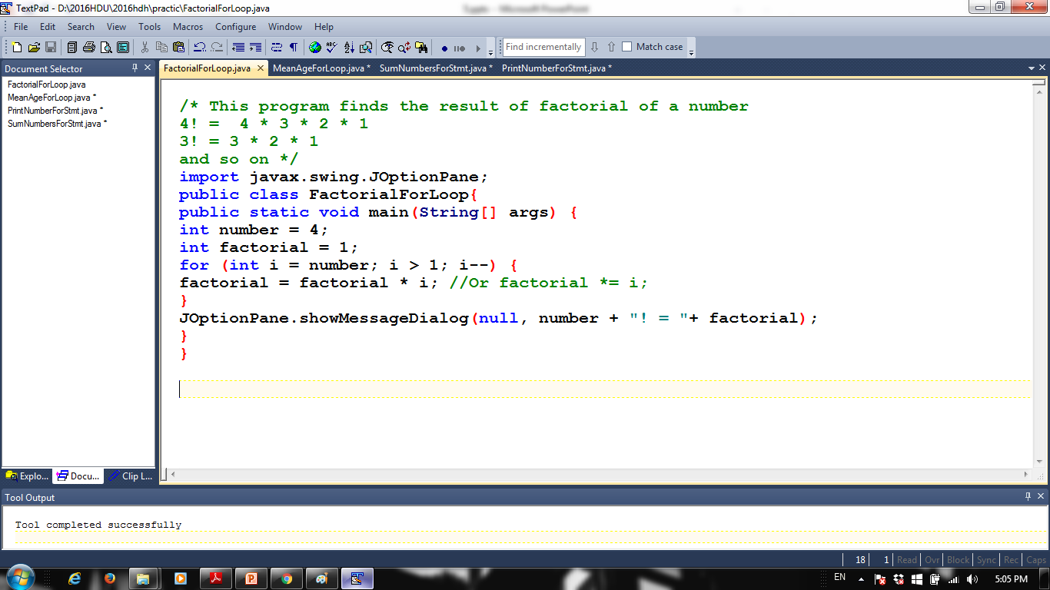
Example 5: for loop

Slide 30
Homework
Write a program to find summation of numbers between 1 and x (when x is any number entered by user).
Write a program to find average mark for a student, check if the average is grater than 50 or not (consider the student has 6 subjects).
Write a program to insert marks of 10 students, then show how many students passed in the exam.

Slide 31
Write a times table program. The program should ask a user to input a number, this number is then used as the times table. So if the user enters 10, the 10 times table should be displayed.
Write a program to find the greatest common divisor for two integer numbers.
Write a program to determine if a number is prime or not.
(hint: a number is said to be prime if it can be divided by 1 and itself).

Slide 32
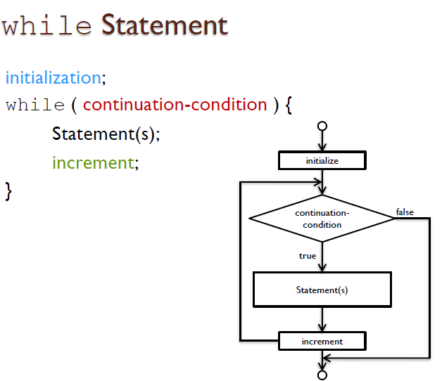
While Statement

Slide 33
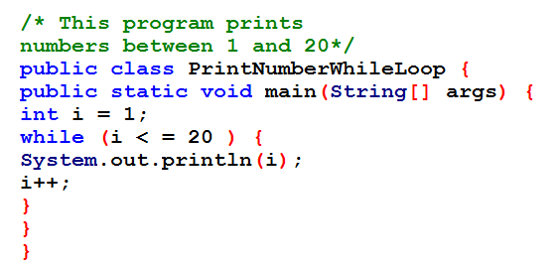
Example 1: while Statement

Slide 34
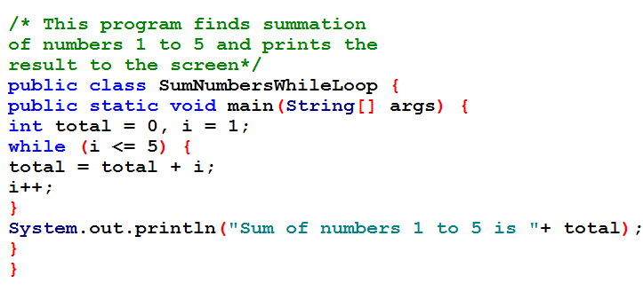
Example 2: while Statement

Slide 35
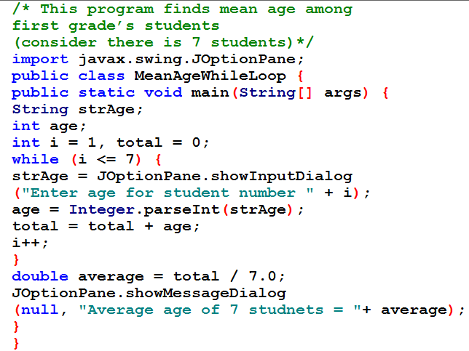
Example 3: while Statement

Slide 36
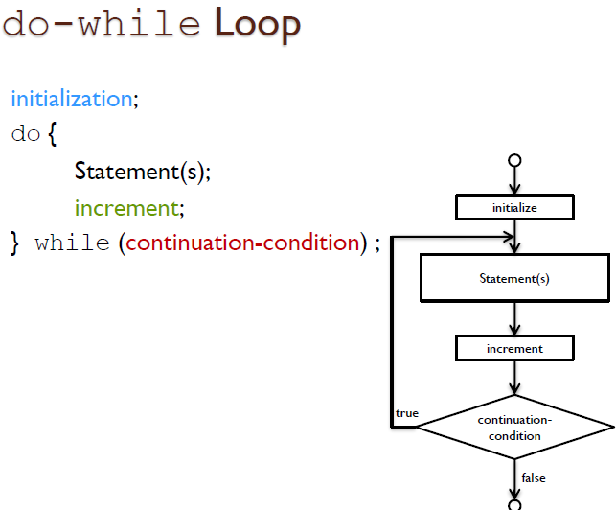
do-while Loop

Slide 37
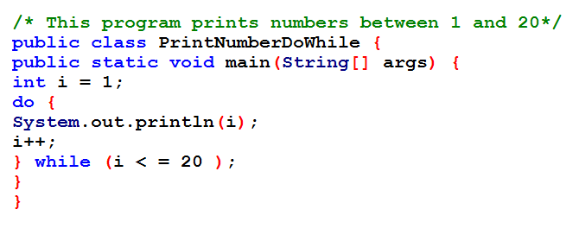
Example 1: do-while Loop

Slide 38
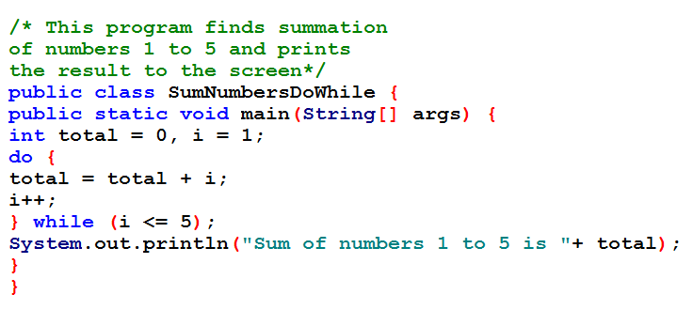
Example 2: do-while Statement

Slide 39
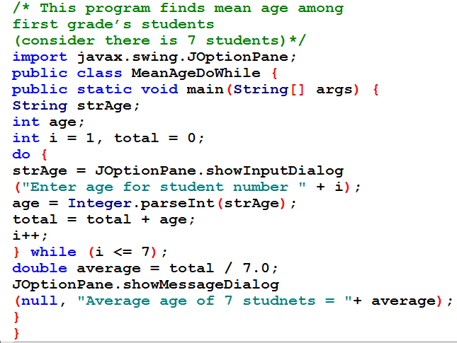
Example 3: do-while Statement

Slide 40
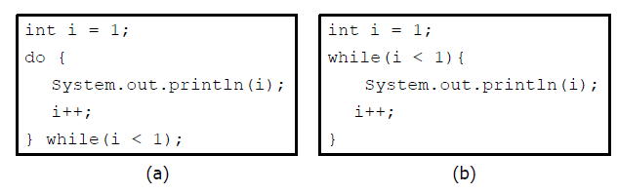
While vs. do-while Loop
Compare the examples below:
The do-while loop (a) will always print something even if I is 1.
The while loop (b) won’t print anything if i is 1.

Slide 41

Nested loop
A loop can contain another loop.
When you "nest" two loops, the outer loop takes control of the number of complete repetitions of the inner loop.
All types of loops may be nested, but the most commonly nested loops are for loops.

Slide 42
Nested loop Example
When you want to:
Write a program that prints multiplication table.
Find average of 10 students (each student has 7 subjects).
Sort 10 numbers in ascending order.

Slide 43
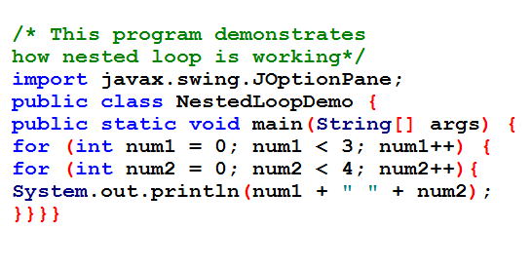
Example 1: Nested loop

Slide 44
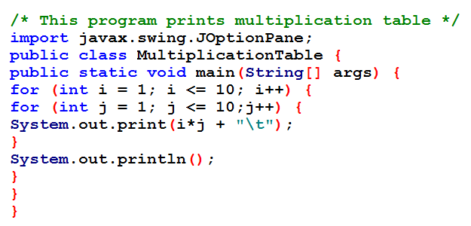
Example 2: Nested loop

Slide 45
Break and continue Statements
Break and continue, can be used in loop statements to provide the loop with additional control.
Break immediately ends the innermost loop that contains it.
Continue only ends the current iteration. Program control goes to the end of the loop body.
Break and continue are generally used with an if statement.

Slide 46
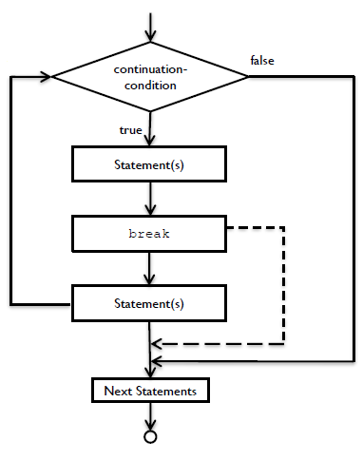
The break Key word
The break statement, when
executed in a while, for,
do-while or switch,
causes immediate exit
from that statement.
Common uses of the
Break statement is to
escape early from a loop.

Slide 47
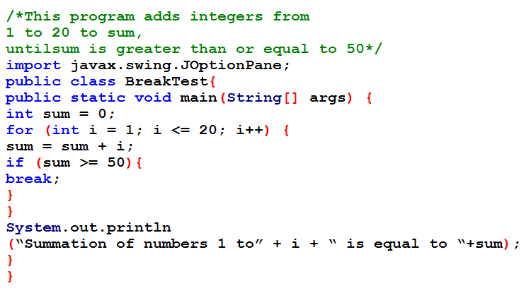
Example : break

Slide 48
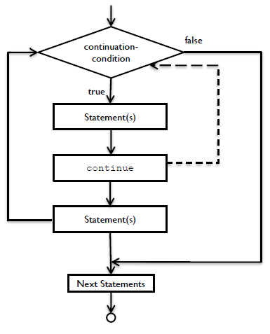
The continue Keyword
The continue statement, when
executed in a while, for or
do-while, skips the
remaining statements
in the loop body and
proceeds with the
next iteration of the
loop.

Slide 49
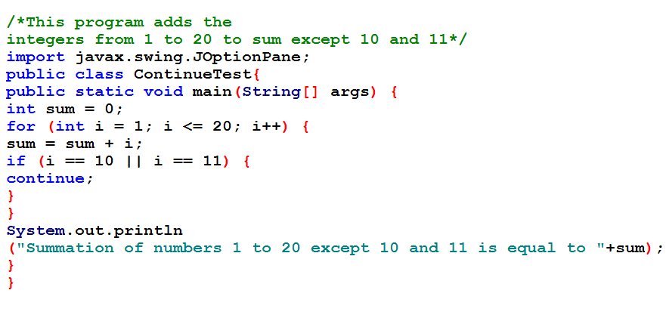
Example : continue

Slide 50
Home work
Try to use each of while and do-while to rewrite the home works in previews home works.
Write a program to find average mark of final exam for 10 student, if you know that each student has 6 subjects, then print the number of students failed.
Write a program that lets the user enter 10 numbers then find the maximum value among the numbers.

